Slide 1

ZillowR Package
Jenna Ford

Slide 2
Documentation
R Interface to Zillow Real Estate and Mortgage Data API
API Calls Available
API
GetChart
GetComps
GetDeepComps
GetDeepSearchResults
GetMonthlyPayments
GetRateSummary
GetSearchResults
GetUpdatedPropertyDetails
GetZestimate
get_Zillow_web_service_id
set_Zillow_web_service_id
zillow_web_service_id

Slide 3
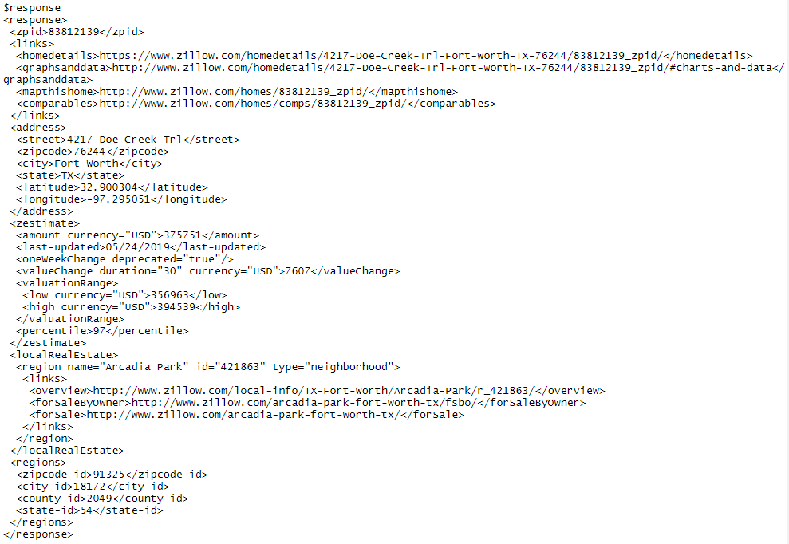
getZestimate
GetZestimate(zpid = 83812139, rentzestimate = FALSE, zws_id = "X1-ZWz17wsd8ldvd7_6le3g",
url = "http://www.zillow.com/webservice/GetZestimate.htm")

Slide 4
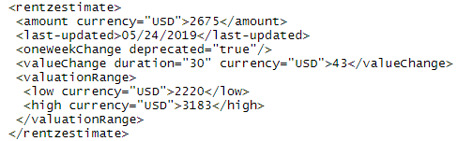
getZestimate
GetZestimate(zpid = 83812139, rentzestimate = TRUE, zws_id = "X1-ZWz17wsd8ldvd7_6le3g",
url = "http://www.zillow.com/webservice/GetZestimate.htm")

Slide 5
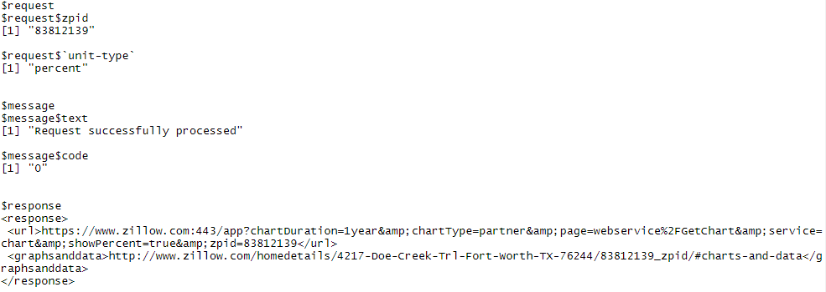
GetChart
GetChart(zpid = 83812139, unit_type = c("percent", "dollar"), width = NULL, height = NULL,
chartDuration = c("1year", "5years", "10years"), zws_id = "X1-ZWz17wsd8ldvd7_6le3g",
url = "http://www.zillow.com/webservice/GetChart.htm")

Slide 6
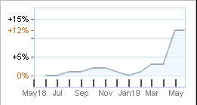
GetChart
https://www.zillow.com/app/?chartDuration=1year&chartType=partner&page=webservice/GetChart&service=chart&showPercent=true&zpid=83812139

